Slide 1
EIGRP
Slides taken from S Ward Abingdon and Witney College and
St. Clair College in Windsor, Ontario
Notes:
EIGRP
S Ward Abingdon and Witney College

Slide 2
Topics
Background and history of EIGRP
Features and operation of EIGRP
Basic EIGRP configuration
EIGRP’s composite metric
Concepts and operation of DUAL
More EIGRP configuration commands

Slide 3
Routing protocols
Interior
Exterior
Distance vector
Link state
RIP v1
RIP v2
IGRP
EIGRP
OSPF
IS-IS
EGP
BGP

Slide 4
EIGRP- Characteristics
Cisco proprietary – only on Cisco routers
Developed from the older IGRP (classful)
EIGRP is classless, supports VLSM, CIDR
Offers load balancing across 6 paths to a destination.
Distance Vector Routing Protocol
But has some features more typical of Link State which are ….

Slide 5
EIGRP- Characteristics
Uses multicast addresses
Creates loop free topology
Has faster convergence
Has little network overhead
Has a composite metric

Slide 6
EIGRP atypical features
Establishing Adjacencies
Neighbour and Topology Tables
Diffusing Update Algorithm (DUAL)
Protocol Independent modules
Reliable Transport Protocol (RTP)
Bounded Updates

Slide 7
Routing Tables and Updates
Neighbor Table:
  Lists all adjacent or neighbour routers.
Topology Table:
  Includes route entries for all destinations that the router has learned.
Routing Table:
  EIGRP chooses the best routes to a destination from the topology table and places these routes in the routing table.

Slide 8
Neighbor Tables
Neighbours are routers on a shared network, running EIGRP.
When newly discovered neighbours are learned, the address and interface of the neighbour is recorded.
When a neighbour sends a hello packet, it advertises a hold time.
Hellos received = neighbour still up, its routes are still valid.
No Hello? Wait for holdtime (3 hello intervals) and if still no Hello then neighbour is down.

Slide 9
Topology Table
The topology table is made up of all the EIGRP routing tables in the autonomous system.
All learned routes to a destination are maintained in the topology table.
Diffusing Update Algorithm (DUAL) is the convergence algorithm used by EIGRP.
DUAL uses the information in the topology tables to calculate the lowest cost routes to each destination.
DUAL is unlikely to produce routing loops. Therefore it does not need to rely on holddown timers and can converge more quickly.

Slide 10
Network layer protocols
EIGRP can support more than one network layer protocol, e.g. IP, IPX, Appletalk.
It has protocol dependent modules to support the different network layer protocols.
It keeps separate routing tables, neighbor tables and topology tables for the different network layer protocols.
The main EIGRP software is independent of the network layer protocol.

Slide 11
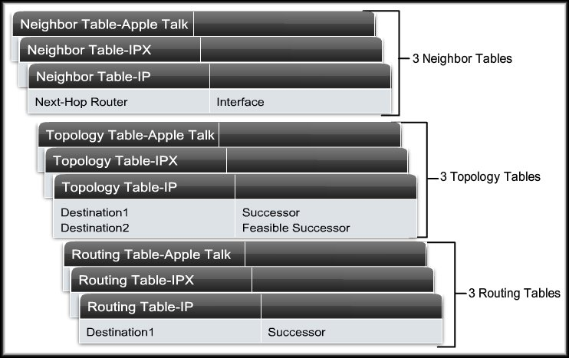
Protocol-Dependant Modules
Protocol-Dependant Modules are responsible for the specific routing tasks for each network layer protocol.

Slide 12
Reliable Transport Protocol
Reliable Transport Protocol (RTP) is the protocol used by EIGRP for the delivery and reception of EIGRP packets instead of TCP and UDP.
RTP includes both reliable delivery and unreliable delivery of EIGRP packets, similar to TCP and UDP.
TCP and UDP are not used because that would tie EIGRP to the TCP/IP suite, and it was designed to be independent.

Slide 13
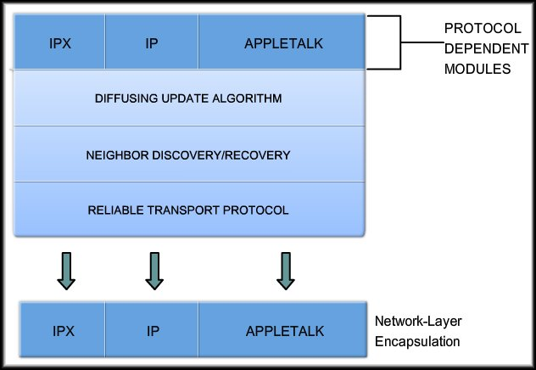
RTP and EIGRP Packet Types

Slide 14
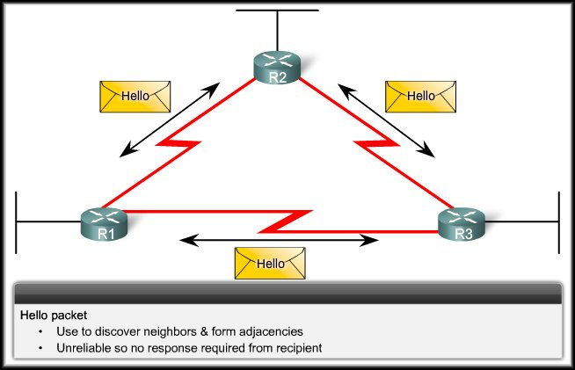
RTP and EIGRP Packet Types
Hello Packet

Slide 15
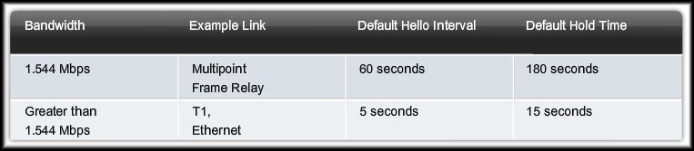
Hello Protocol
Most Networks
Before any EIGRP packets can be exchanged between routers, EIGRP must first discover its neighbors.
EIGRP routers discover neighbors and establish adjacencies with neighbor routers using the hello packet.
Hold Time:
  An EIGRP router assumes that as long as it is receiving hello packets from a neighbor, the neighbor and its routes remain viable.

Slide 16
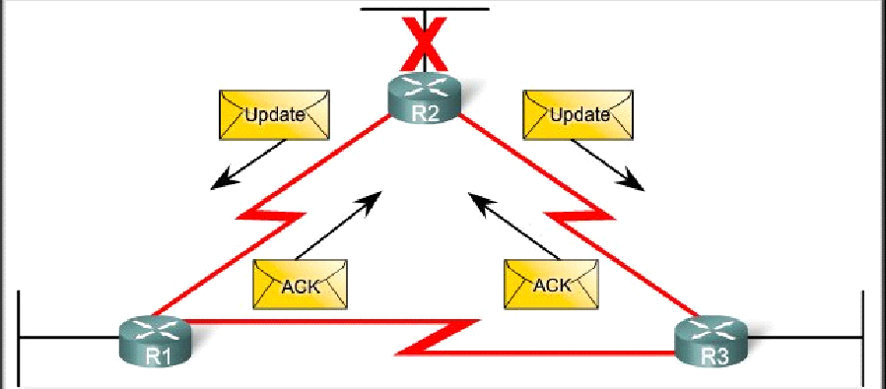
RTP and EIGRP Packet Types
Update and Acknowledgment Packets

Slide 17
Update packets
Used to propagate routing information.
No periodic updates.
Sent only when necessary.
Include only required information
Sent only to those routers that require it.
Reliable delivery.
Multicast if to several routers, unicast if to one router.

Slide 18
Update packets
EIGRP updates are sent only when a route changes.
EIGRP updates are partial. They include only information about the changed route.
EIGRP updates are bounded. They go only to routers that are affected by the change.
This keeps updates small and saves bandwidth.

Slide 19

Acknowledgement (ACK) packets
Sent when reliable delivery is used by RTP.
Sent in response to update packets.
Unreliable delivery
Unicast
Update (reliable)
ACK (unreliable)

Slide 20
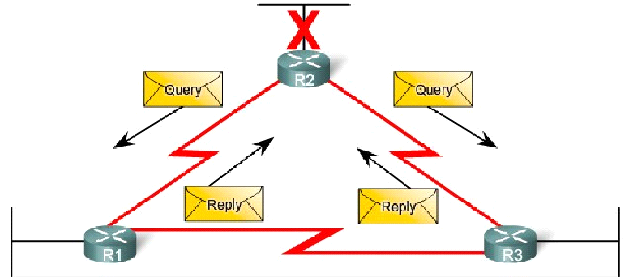
RTP and EIGRP Packet Types
Query and Reply Packets

Slide 21
Query packet
Used when searching for a network
E.g. a route goes down. Is there another route?
Uses reliable delivery so requires ACK
Multicast or unicast
All neighbours must reply
Query (reliable)
ACK (unreliable)

Slide 22
Reply packet
Sent in response to a query from a neighbour.
Sent reliably so requires ACK.
Unicast
Query (reliable)
ACK (unreliable)
Reply (reliable)
ACK (unreliable)

Slide 23
Summary of message types
 | Unicast | Multicast | Either
Reliable | Reply |  | Update Query
Unreliable | ACK | Hello

Slide 24
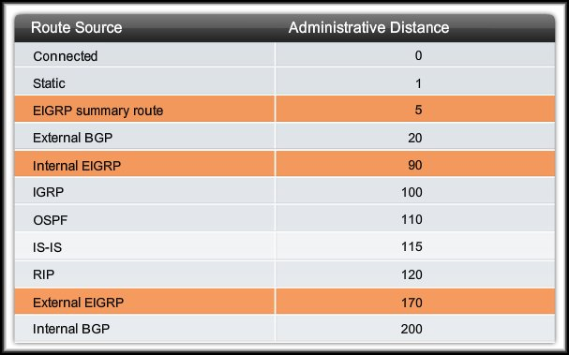
Administrative Distance
When compared to other interior gateway protocols, EIGRP is the most preferred by the Cisco IOS software because it has the lowest AD.

Slide 25
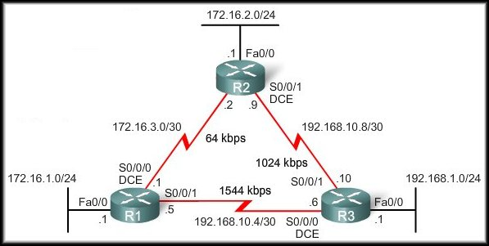
EIGRP
Basic EIGRP Configuration

Slide 26
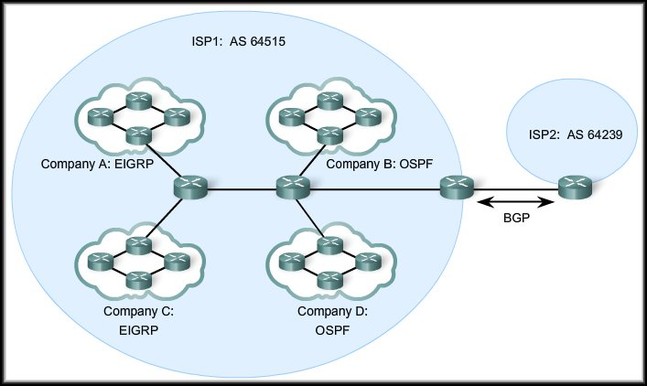
Autonomous System
Autonomous system numbers are assigned by the Internet Assigned Numbers Authority (IANA).
Who needs an Autonomous System number?
  Internet Service Providers (ISPs), Internet Backbone Providers, and large institutions connecting to other entities that also have an autonomous system number..
A network or group of networks identified and administered as a single entity.

Slide 27
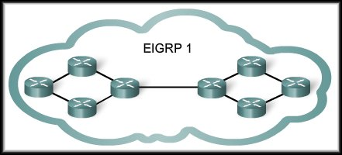

Process ID
Although EIGRP refers to
the parameter as an
“autonomous-system”
number, it actually functions
as a Process ID.
The autonomous system parameter is a number chosen by the network administrator between 1 and 65,535.

Slide 28
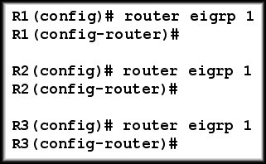
The router eigrp Command
The Global configuration mode router eigrp command enables EIGRP.
All routers in an EIGRP routing domain must use the same process ID number (autonomous system number).
Notes:
EIGRP
S Ward Abingdon and Witney College
Although EIGRP refers to the parameter as an
autonomous-system”
number, it actually functions
as a Process ID.

Slide 29
The network Command
The network command in EIGRP has the same function as in other IGP routing protocols:
  Any interface on this router that matches the network address in the network command will be enabled to send and receive EIGRP updates.
  This network (or subnet) will be included in EIGRP routing updates.

Slide 30
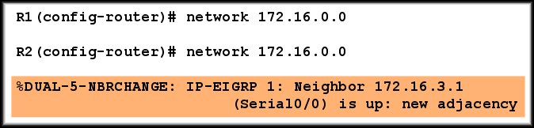
The network Command
The network-address is the classful network address for this interface.
A single classful network statement is used on R1 to include both 172.16.1.0/24 and 172.16.3.0/30 subnets.

Slide 31
The network Command
If you enter the individual network numbers for the interfaces, the Cisco IOS software will automatically convert them to a single, summarized network.

Slide 32
The network Command
When EIGRP is configured on R2, DUAL sends a notification message to the console stating that a neighbor relationship with another EIGRP router has been established.

Slide 33
The network Command
This new adjacency happens automatically because both R1 and R2 are using the same EIGRP 1 routing process and both routers are now sending updates on the 172.16.0.0 network.

Slide 34
The network Command with a Wildcard Mask
By default, when the network command and a classful network address such as 172.16.0.0 are used, all interfaces on the router that belong to that classful network address will be enabled for EIGRP.
There may be times when the network administrator does not want to include all interfaces within a network when enabling EIGRP.
To configure EIGRP to advertise specific subnets only, use the wildcard-mask option.

Slide 35
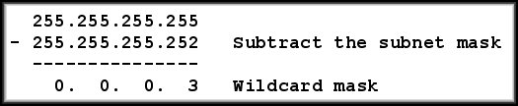
The network Command with a Wildcard Mask
Think of a wildcard mask as the inverse of a subnet mask.
To calculate the inverse of the subnet mask, subtract the subnet mask from 255.255.255.255.

Slide 36
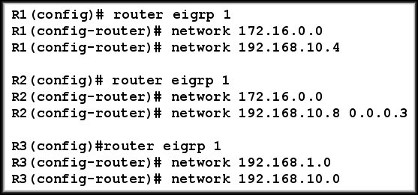
Network EIGRP Configuration

Slide 37
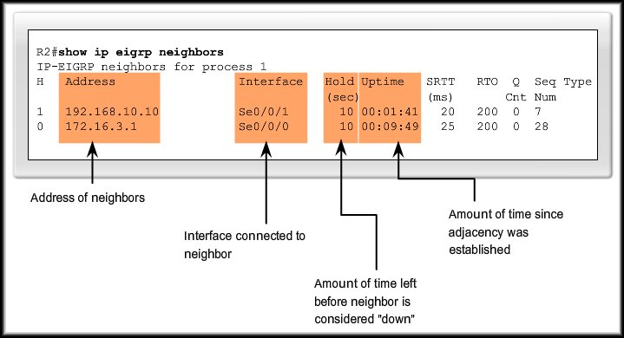
Verifying EIGRP
Verify adjacencies using show ip eigrp neighbors.

Slide 38
Show ip protocols
Details of EIGRP configuration
Networks being advertised
Sources of information

Slide 39
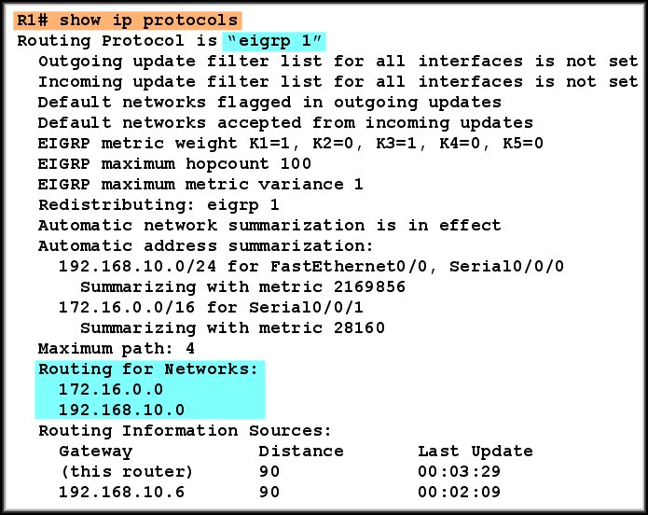
Verifying EIGRP

Slide 40
Verifying EIGRP
Troubleshooting:
  If a neighbor is not listed
  after adjacencies have
  been established with a
  router’s neighbors,
  check that the local
  interface is activated using the show ip interface brief command.
  If the interface is active, ping the IP address of the neighbor.
    If the ping fails, it means that the neighbor interface is down and needs to be activated.

Slide 41
Verifying EIGRP
Troubleshooting:
  If the ping is successful
  and EIGRP still does not
  see the router as a
  neighbor, examine the
  following configurations:
    Are both routers configured with the same EIGRP process ID?
    Is the directly connected network included in the EIGRP network statements?
    Is the passive-interface command inappropriately configured, thus preventing EIGRP hello packets on the interface?

Slide 42
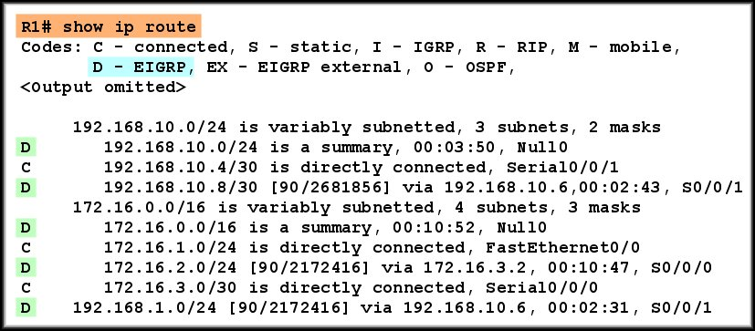
Examining The Routing Table: R1
Notice that EIGRP routes are denoted in the routing table with a D, which stands for DUAL.

Slide 43
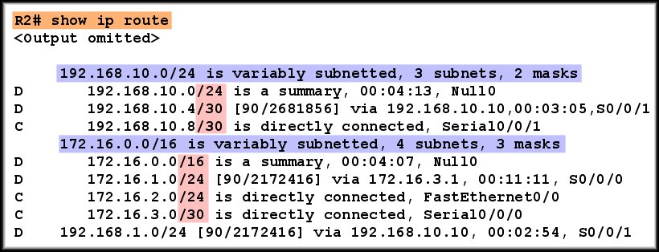
Examining The Routing Table: R2
EIGRP is a classless routing protocol (includes the subnet mask in the routing update).
EIGRP supports variable-length subnet masks (VLSM) and classless inter-domain routing (CIDR).

Slide 44
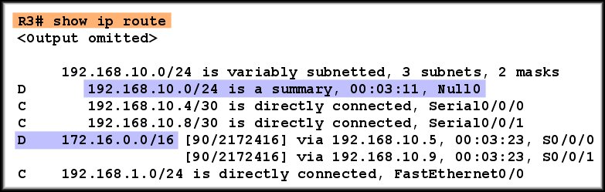
Examining The Routing Table: R3
By default, EIGRP automatically summarizes routes at the major network boundary.
You can disable the automatic summarization with the
no auto-summary command, just as you did for RIPv2.

Slide 45
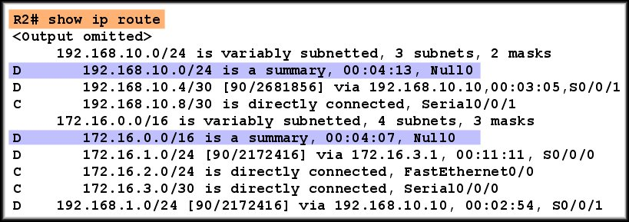
Introducing the Null0 Summary Route
EIGRP automatically includes a Null0 summary route as a child route whenever both of the following conditions exist:
  There is at least one subnet that was learned via EIGRP.
  Automatic summarization is enabled.

Slide 46
Introducing the Null0 Summary Route
The 192.168.10.0/24 and 172.16.0.0/16 routes do not actually represent a path to reach the parent networks.
If the packet matches the level 1 parent, but none of the child route subnets, the packet is discarded (sent to the Null0 interface).

Slide 47
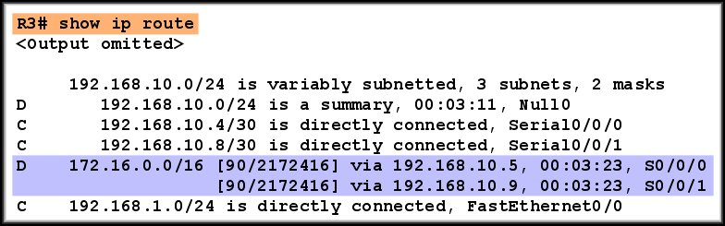
R3 Routing Table
Because R3 is getting equal cost routes for 172.16.0.0/16 from R1 and R2, both are included in the routing table.
Both R1 and R2 are automatically summarizing the 172.16.0.0/16 network and sending it as a single routing update.

Slide 48
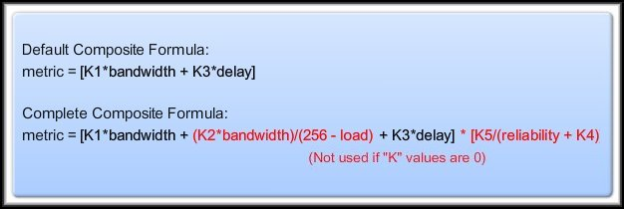
EIGRP
EIGRP Metric Calculation

Slide 49
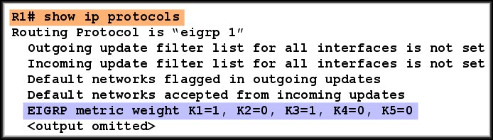
K values
Leave them alone unless there is a very good reason to change them.
Router(config-router)#metric weights tos k1 k2 k3 k4 k5
tos (type of service) must be 0

Slide 50
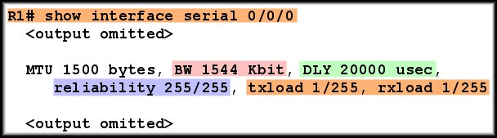
Metric values in use
usec means microseconds. It should be μsec but the μ symbol is not available.

Slide 51
Reliability and Load
Reliability is measured dynamically. It measures the frequency of errors and the probability that the link will fail.
255 is totally reliable, 0 is totally unreliable.
Load is measured dynamically. It shows the amount of traffic using the link.
1/255 is minimal load. 255/255 is fully saturated.
Both transmit and receive load are measured.

Slide 52
Bandwidth
The actual bandwidth is NOT measured.
Most serial interfaces use the default T1 bandwidth value of 1544 Kbps (1.544 Mbps).
If this is not close to the actual bandwidth then change the bandwidth setting.
Router(config-if)#bandwidth 64
This does not change the bandwidth of the link.

Slide 53
Using bandwidth
Take the lowest bandwidth value in the path.
Calculate (10,000,000/bandwidth) * 256
This is the bandwidth part of the metric.
Just to confuse you, this is also called “bandwidth” in the formula:
metric = “bandwidth” + delay

Slide 54
Delay
Delay is a measure of the time it takes for a packet to traverse a route.
Delay is not measured dynamically.
Default values are used, e.g.
  Serial interfaces 20,000 microseconds
  FastEthernet interfaces 100 microseconds
The delay value can be changed.

Slide 55
Using delay
Find the delay value on every outgoing interface along the path.
Add up all these values.
Delay metric = (sum of delay/10)* 256
Just to confuse you, this is also called “delay” in the formula:
metric = “bandwidth” + “delay”

Slide 56
Example step 1
Metric to this network?
BW 1,024 Kbps
delay 20000
BW 100,000 Kbps
delay 100
Bandwidth metric = (10,000,000/1024)*256
Round 10,000,000/1024 to a whole number before multiplying by 256
Bandwidth metric = 2,499,840.

Slide 57
Example step 2
Metric to this network?
BW 1,024 Kbps
delay 20000
BW 100,000 Kbps
delay 100
Delay metric = (sum of delay/10)* 256
= (20100/10)*256
= 514560

Slide 58
Example step 3
Metric to this network?
BW 1,024 Kbps
delay 20000
BW 100,000 Kbps
delay 100
Bandwidth metric = 2,499,840
Delay metric = 514560
Bandwidth + delay = 3014400
This is the metric calculated by the router on the left.

Slide 59
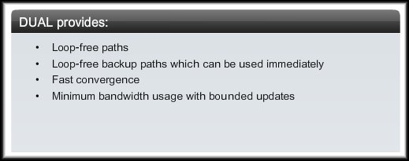
EIGRP
DUAL

Slide 60
DUAL Concepts
  Successor.
  Feasible distance.
  Feasible successor.
  Reported distance or advertised distance.
  Feasible condition or feasibility condition.

Slide 61

Successor and Feasible Distance
A successor is:
  A neighboring router that is used for packet forwarding.
  The least-cost route to the destination network.
The IP address of a successor is shown in a routing table entry right after the word via.

Slide 62

Successor and Feasible Distance
Feasible Distance (FD):
  Is the lowest calculated metric to reach the destination network.
  As with other routing protocols, this is the metric for the route.

Slide 63
Feasible Successors
Successor Route
Feasible Successor Route
A Feasible Successor (FS) is a neighbor who has a loop-free backup path to the same network as the successor.

Slide 64
Feasible Successors
One of the reasons DUAL can converge quickly after a change in the topology is because it can use backup paths to other routers known as feasible successors without having to re-compute DUAL.

Slide 65
Feasibility Condition and Reported Distance
How does a route become
a Feasible Successor?
  It must meet the
  Feasibility Condition.
Feasibility Condition (FC):
  The FC is met when a neighbor’s Reported Distance to a network is less than the local router’s Feasible Distance to the same destination network.
Feasible Successor Route

Slide 66

Feasibility Condition and Reported Distance
Both R1 and R2 have loop-free Successor Routes to the same destination network.

Slide 67

Feasibility Condition and Reported Distance
R1 sends an update to R2 that includes its metric (FD).

Slide 68
Feasibility Condition and Reported Distance
FD to 192.168.1.0/24
RD to 192.168.1.0/24
R2 considers R1’s metric as a Reported Distance to the same network.
RD is less than the FD.
Feasibility Condition met.

Slide 69
Feasibility Condition and Reported Distance
FD to 192.168.1.0/24
RD to 192.168.1.0/24
R2 adds the route from R1 to the topology table as the Feasible Successor route to network 192.168.1.0/24.

Slide 70
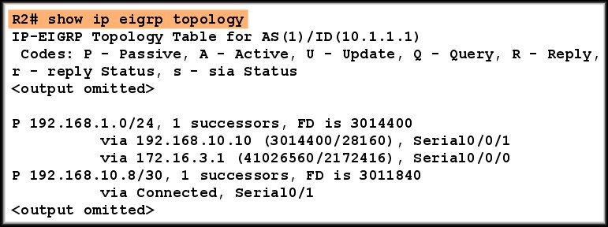
Topology Table
Successor and Feasible Successor:
  The Successor, Feasible Distance, and any Feasible Successors with their Reported Distances are kept by a router in its EIGRP topology table.

Slide 71
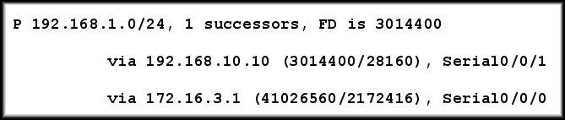
Topology Table: Successor
Two States:
Active (A): Being recalculated by DUAL.
Passive (P): A stable successor route.
Destination Network
Feasible Distance to Successor
Number of Successors

Slide 72
Topology Table: Successor
Next Hop address for Successor
R3’s Reported Distance
Outbound Physical Interface

Slide 73
Topology Table: Feasible Successor
Next Hop address for Feasible Successor
Feasible Successor’s Reported Distance
R2’s new FD to 192.168.1.0/24 if R1 became the Feasible Successor.
Physical Interface

Slide 74
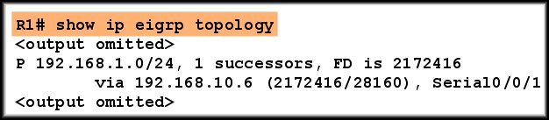
Topology Table: NO Feasible Successor
The above is a portion of R1’s topology table that shows its link to network 192.168.1.0/24.
  Why has R2’s route NOT become the feasible successor for R1?
    It does not meet the Feasibility Condition.
EIGRP is a distance vector routing protocol and only knows about remote network information through its neighbors.

Slide 75
Recalculation
Other loop-free routes can be found if necessary but DUAL has to do the calculation again on the basis of the latest information.
Successor route fails
No feasible successor (back-up)
Query neighbours for routes and get replies
Calculate and find new successor if one exists

Slide 76
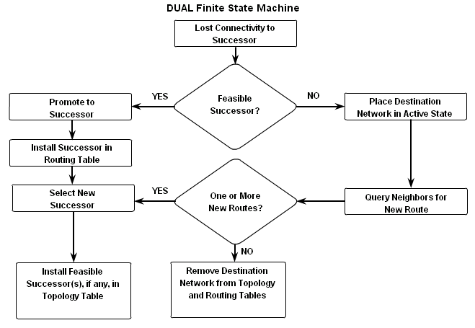
DUAL finite state machine
A set of possible states
Events that lead to the states
Events that result from the states
Think “flow chart”

Slide 77
debug eigrp fsm
Displays DUAL activity e.g. when a link goes down or comes up.
DUAL: Find FS for dest 192.168.1.0/24. FD is 3014400, RD is 3014400
DUAL: 192.168.10.10 metric 4294967295/4294967295
DUAL: 172.16.3.1 metric 41026560/2172416 found Dmin is 41026560
DUAL: Removing dest 192.168.1.0/24, nexthop 192.168.10.10
DUAL: RT installed 192.168.1.0/24 via 172.16.3.1

Slide 78
EIGRP
More EIGRP Configurations
Null0 Summary Route
Disable Automatic Summarization
Manual Summarization
EIGRP Default Route

Slide 79
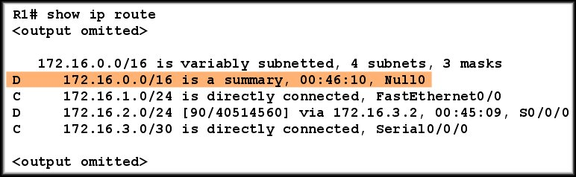
The Null0 Summary Route
EIGRP automatically includes a Null0 summary route as a child route whenever both of the following conditions exist:
  There is at least one subnet that was learned via EIGRP.
  Automatic summarization is enabled (default).
R1 will discard any packets that match the parent classful network but do not match one of the child routes.

Slide 80
Disabling Automatic Summarization
Both R1 and R2 automatically summarized the subnets and sent an update to R3.
172.16.0.0/16
172.16.0.0/16
Like RIP, EIGRP automatically summarizes at major network boundaries using the default auto-summary command.

Slide 81
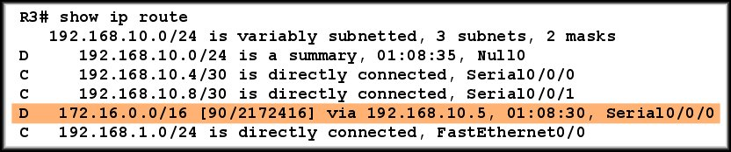
Disabling Automatic Summarization
The result is that R3 has one route to 172.16.0.0/16
through R1.
R1 is the successor because of the difference in bandwidth.

Slide 82
Disabling Automatic Summarization
R3 will route all packets destined for 172.16.2.0 through R1.
R3 does not know that R1 will then have to route these packets across a very slow link to R2 (64 Kbps).

Slide 83
Disabling Automatic Summarization
In other words, R1 and R2 must stop automatically summarizing 172.16.0.0/16.
The only way R3 can learn about this slow bandwidth is if R1 and R2 send individual routes for each of the 172.16.0.0/16 subnets.

Slide 84
Disabling Automatic Summarization
R2(config)# router eigrp 1
R2(config-router)# no auto-summary
R1(config)# router eigrp 1
R1(config-router)# no auto-summary
R3(config)# router eigrp 1
R3(config-router)# no auto-summary
Automatic summarization can be disabled with the
no auto-summary command.

Slide 85
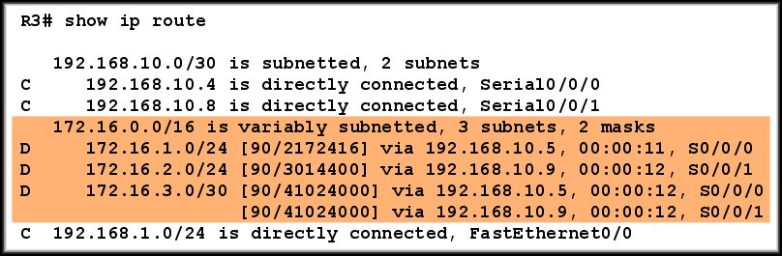
Disabling Automatic Summarization
Before
After
Without automatic summarization, R3’s routing table now includes the three subnets.

Slide 86
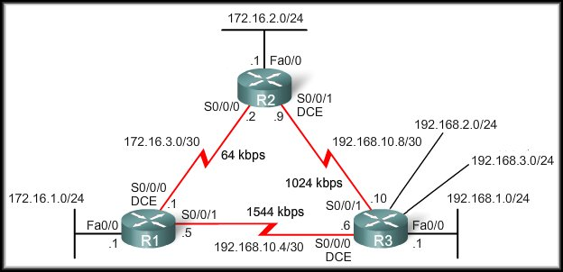
Manual Summarization
EIGRP can be configured to summarize routes, whether or not automatic summarization is enabled.
  Modify the topology to add two more networks to R3.

Slide 87
Manual Summarization
R1# show ip route
D 192.168.1.0/24 [90/2172416] via 192.168.10.6, 02:07:38, S0/0/1
D 192.168.2.0/24 [90/2297856] via 192.168.10.6, 00:00:34, S0/0/1
D 192.168.3.0/24 [90/2297856] via 192.168.10.6, 00:00:18, S0/0/1
Instead of sending three separate networks, R3 can summarize the 192.168.1.0/24, 192.168.2.0/24, and 192.168.3.0/24 networks as a single route.

Slide 88

Manual Summarization
Write out the networks that you want to summarize in binary.
Find the matching bits.
Count the number of leftmost matching bits, which in this example is 22.
This number becomes your subnet mask for the summarized route ( /22 or 255.255.252.0) .
To find the network address for summarization, copy the matching 22 bits and add all 0 bits to the end to make 32 bits.
The result is the summary network address and mask for 192.168.0.0/22

Slide 89
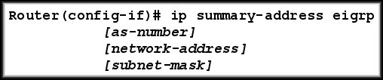
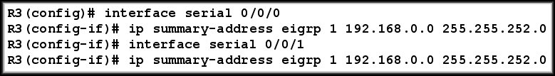
Configure EIGRP Manual Summarization
Because R3 has two EIGRP neighbours, EIGRP manual summarization is configured on both serial interfaces and will be propagated to the neighbours.

Slide 90
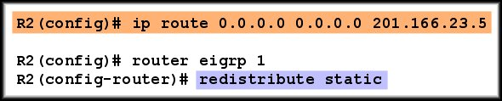
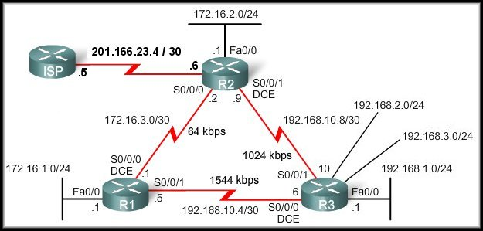
EIGRP Default Route
Using a static route to 0.0.0.0/0 as a default route is not routing protocol dependent.
EIGRP requires the use of the redistribute static command to include this static default route with its updates.

Slide 91
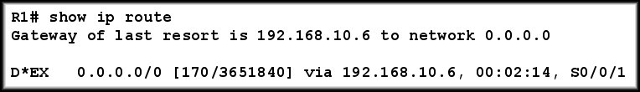
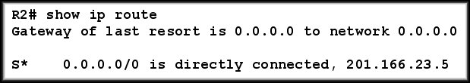
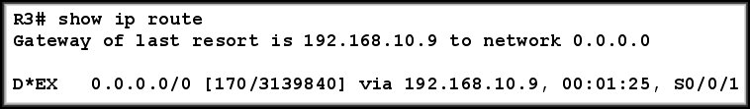
EIGRP Default Route

Slide 92
EIGRP Default Route
In the routing tables for R1 and R3, notice the routing source and AD for the new static default route.
  D - This static route was learned from an EIGRP routing update.
  * - The route is a candidate for a default route.
  EX - The route is an external EIGRP route, in this case a static route outside of the EIGRP routing domain.
  170 - This is the AD of an external EIGRP route.

Slide 93

Fine-Tuning EIGRP
By default, EIGRP uses only up to 50 percent of the bandwidth of an interface for EIGRP information.
This prevents the EIGRP process from over-utilizing a link and not allowing enough bandwidth for the routing of normal traffic.
The ip bandwidth-percent eigrp command can be used to configure the percentage of bandwidth that may be used by EIGRP on an interface.

Slide 94
Fine-Tuning EIGRP
We can limit EIGRP to no more than 50 percent of the
64 Kbps link’s bandwidth by configuring the following on R1 and R2.

Slide 95


Hello Intervals and Hold times
Hello intervals and hold times are configurable on a per-interface basis and do not have to match with other EIGRP routers to establish adjacencies.
  The seconds value for both hello and holdtime intervals can range from 1 to 65,535
If you change the hello interval, make sure that you also change the hold time to a value equal to or greater than the hello interval.
Otherwise, neighbor adjacency will go down after the hold time expires and before the next hello interval.

Slide 96
Show commands
show ip eigrp topology
for basic topology table
show ip eigrp topology 192.168.1.0
for full details of routes to 192.168.1.0 including metrics used and hop count
show ip eigrp topology all-links
for all known routes including routes that are not successors or feasible successors

Slide 97
Is it very complicated?
No. Basic EIGRP configuration is simple.
Router(config)#router eigrp 1
Router(config-router)#network 192.168.1.0
Router(config-router)#network 192.168.2.0

Slide 98
The End

